Slide 1
Dstarix GenAI Project
AI Recruitment & Candidate Matching Platform
Resumes and a job description go in. A ranked, explained shortlist comes out.
Pratham Kamble · github.com/pratham-kamble/GEN-AI-Project

Slide 2
Screening resumes by hand is slow and inconsistent
One job opening can bring in hundreds of resumes, and reviewing each one against the job description takes a lot of time.
Simple keyword filters can also miss great candidates when they describe their skills or experience differently.
The goal is to build a working hiring pipeline—not just a chatbot. It should parse resumes and job descriptions, extract structured information, understand how well candidates match the role, score and rank them, and clearly explain why each candidate is a good fit.

Slide 3
One pipeline, each stage its own module
Job description > LLM extracts requirements > Resume (PDF / DOCX) > Text extraction > LLM builds profile
Embeddings > Semantic matching > Weighted score > Ranking + skill gaps > LLM explanation
The backend is built with FastAPI, using Groq’s openai/gpt-oss-20b model for the AI-powered stages. Sentence-transformers handle embeddings and semantic matching, while Pydantic keeps the data structured and validated. For now, the application uses an in-memory store.
The highlighted stages are the parts where the LLM is actively involved.

Slide 4
Matching by meaning, not by keywords
Job requirement
Python backend development
Ananya's resume, no keyword overlap Developed and shipped backend services using Python and Django.
Each required skill is embedded and compared with every candidate skill by cosine similarity. A best score of 0.55 or higher counts as a match. Ananya ranked first.

Slide 5
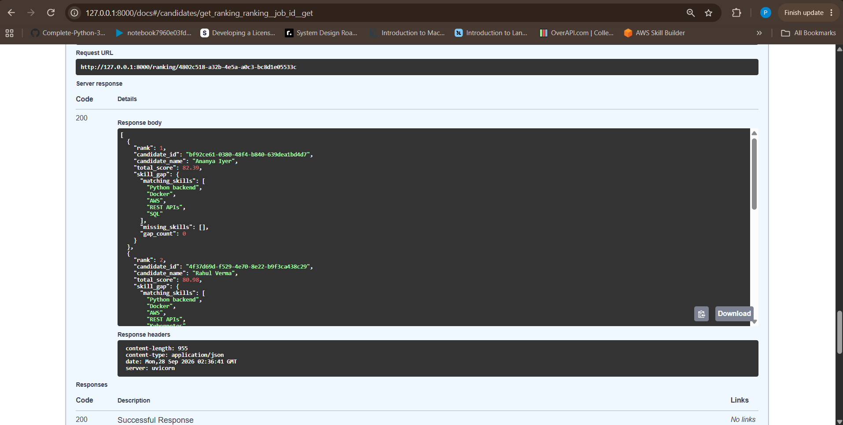
Ranked results with skill gaps and explanations
Ananya Iyer 82.39 and Rahul Verma 80.98 lead. Ananya worded her skills differently from the JD.
Each result lists matching skills, missing skills and a gap count.
The LLM explanation is written from the computed scores, and a failed explanation never blocks the ranking.

Slide 6
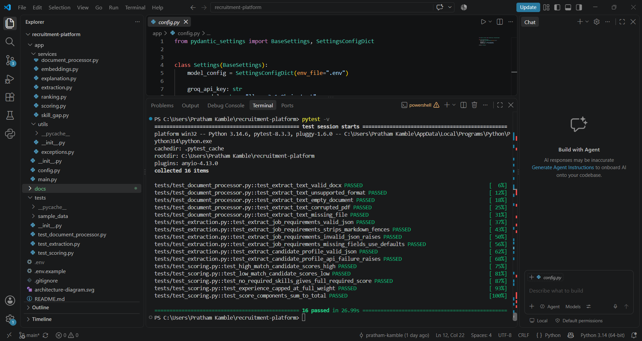
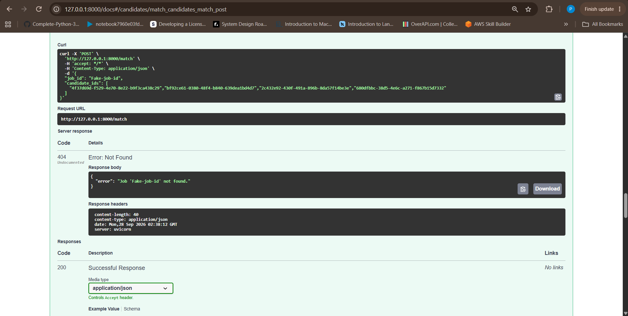
Tested, and failures return clear errors
16 automated tests: extraction, scoring,
document processing. The LLM is mocked.
Unknown job id returns a 404
with a readable message.

Slide 7
Known limits and next steps
Storage is in memory, so data resets on restart. Next: SQLite or PostgreSQL.
The 0.55 threshold is a heuristic. Next: calibrate it on labelled resume and JD pairs.
Extraction can vary between runs, so scores shift slightly. Next: fixed skill taxonomy and caching.
Next: batch upload, OCR for scanned PDFs, a recruiter frontend, authentication.

Slide 8
THANK YOU
.

